Slide 1


Capewell Solid-State Timer
Team 9:
ME: Patrick Dunham and Joshua Reinhart
EE: Patrick Meres, Robert Endrizzi, Nicole Hershman, and Jaileen Algarin
Faculty Advisors: Dr. Rajeev Bansal & Dr. Thanh Nguyen
Sponsor Representative: Andrew Smith
Notes:
Patrick

Slide 2
Presentation Outline
Project Review
Results and Conclusions
PCB
Microcontroller (MCU)
Relays
Power Supply
User Interface (UI)
Mounting Platform
Schedule
Risk Assessment
Notes:
Josh

Slide 3
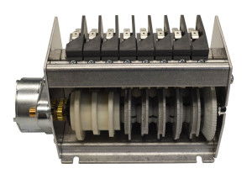
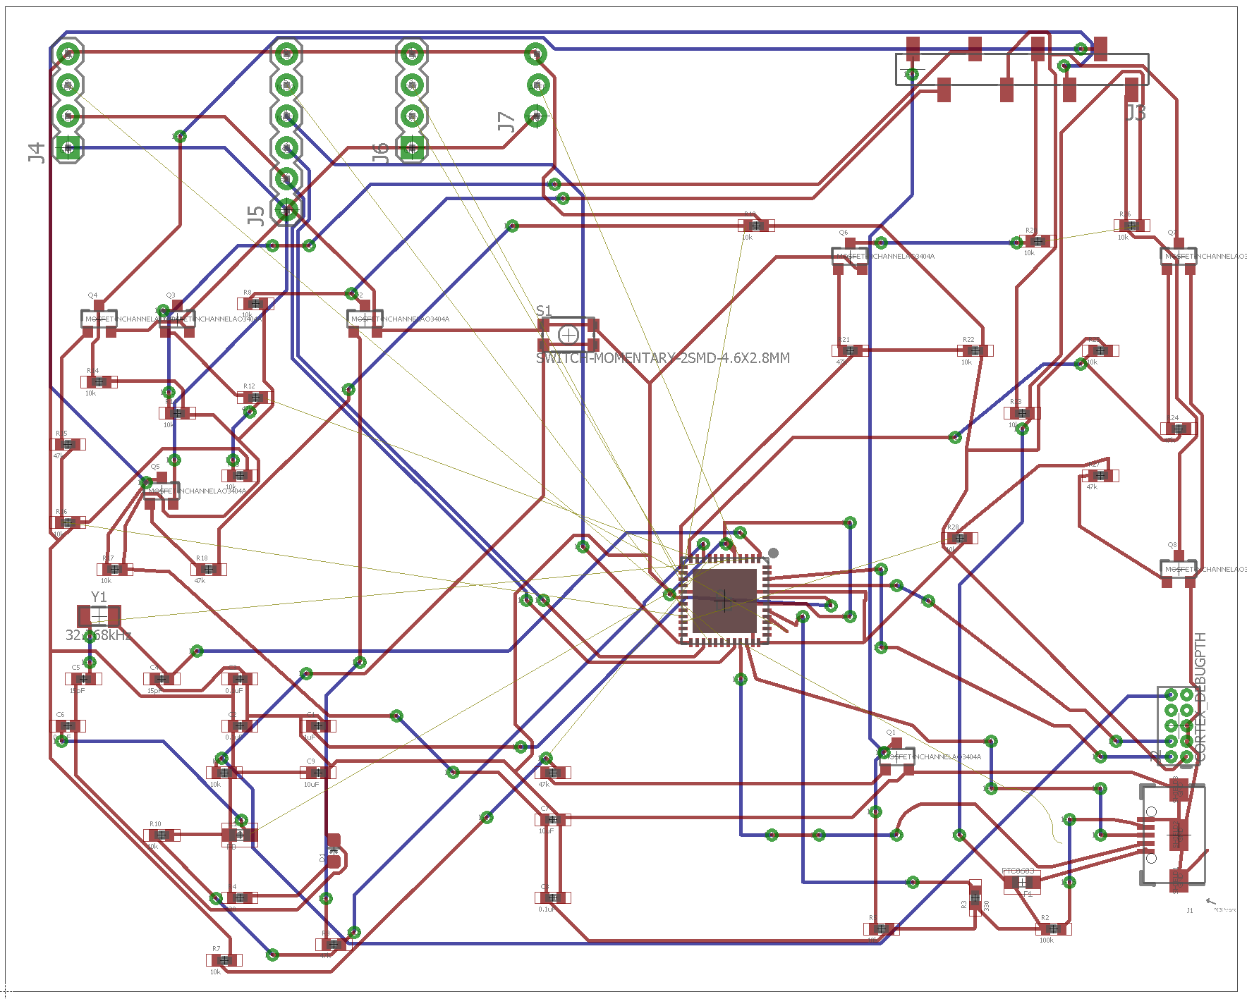
Project Review
Redesign C10B Electromechanical Cycle Timer
Match current timer in size and function
Completely solid-state design
Deliverables: Solid-State Timer Design & Source Code
PCB Design/Schematic
Mounting platform CAD Files
Microcontroller Source Code
Working Prototype
Switches
2.72”
3.3”
5.6”
Motor
Cams
Solid-State Timer PCB
8-Cam C10 Cycle Timer
About Capewell
Notes:
Josh

Slide 4
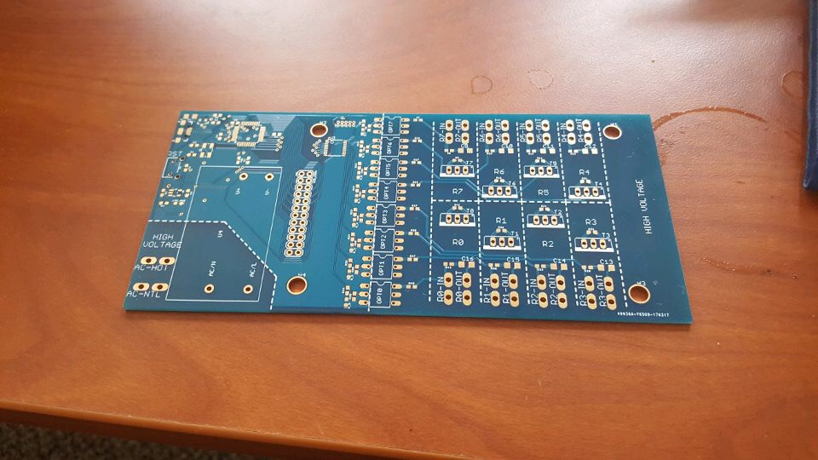
Results: Current PCB (Rev. 1)
2.82”
6.02”
First Full Prototype
Notes:
Patrick

Slide 5
Results: Current PCB (Rev. 1)
Microcontroller
Power
2.82”
Relays
6.02”
First Full Prototype
Notes:
Patrick

Slide 6
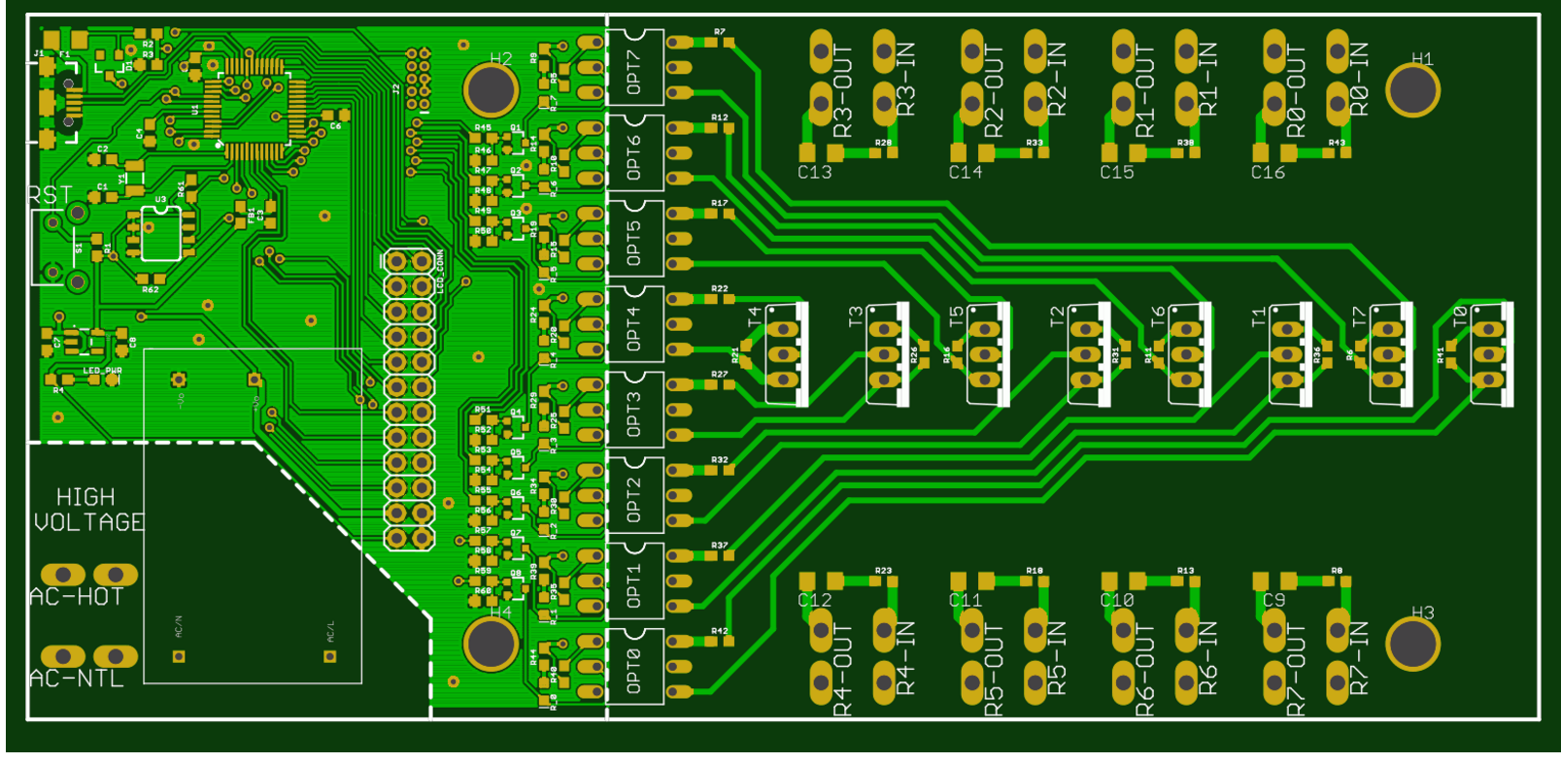
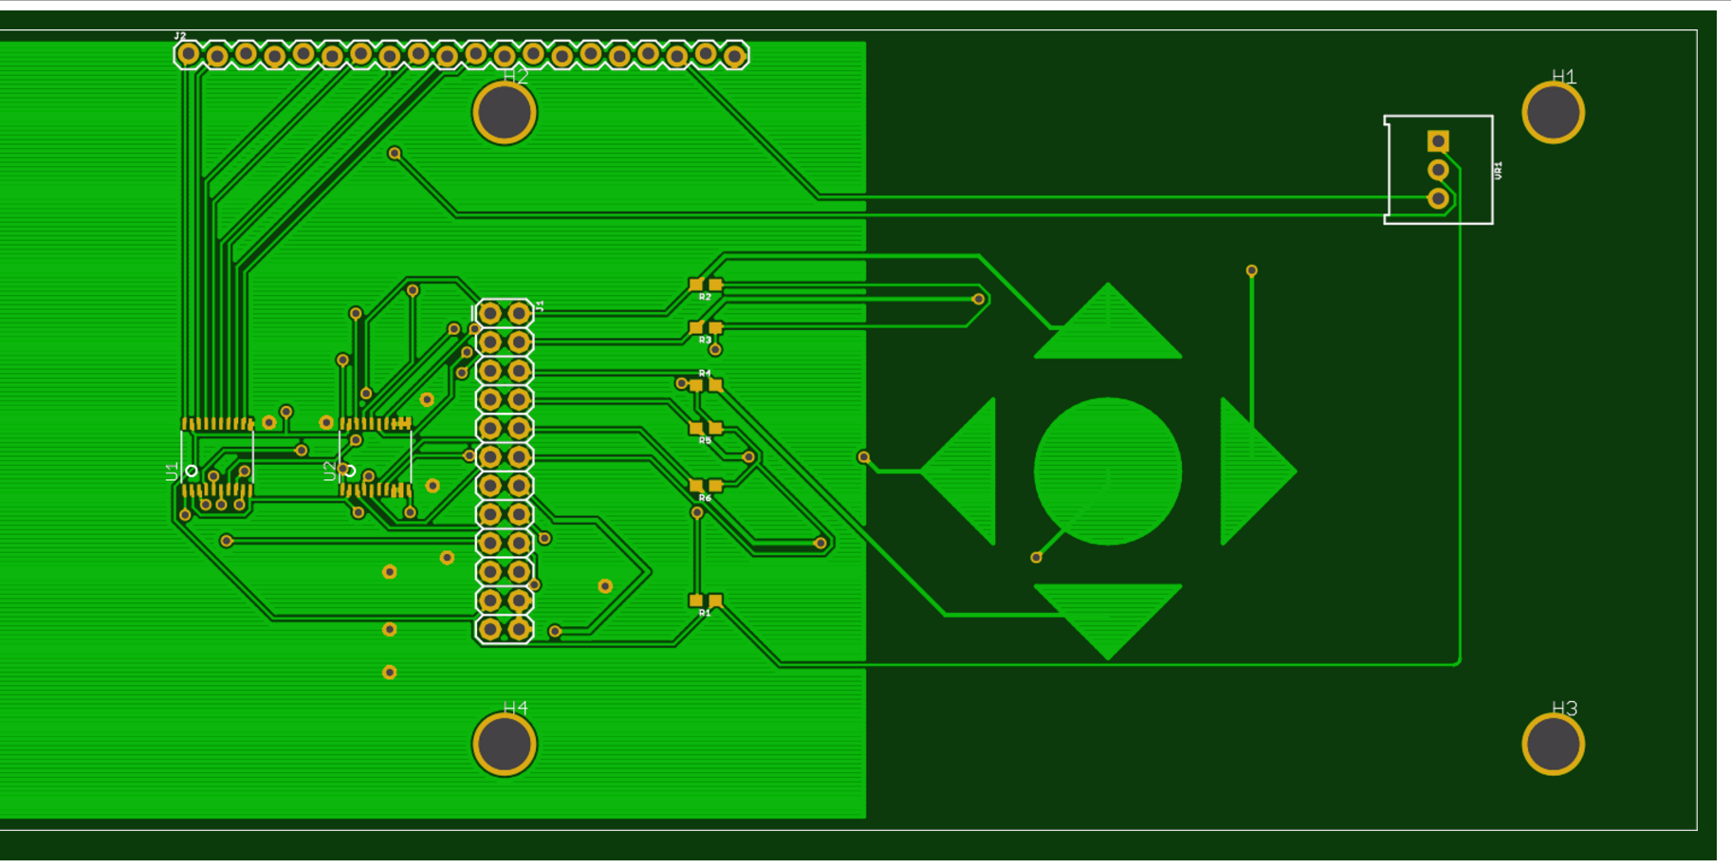
Results: New PCB (Rev. 2)
Timer PCB
LCD PCB
Notes:
Patrick

Slide 7
Results: New PCB (Rev. 2)
MCU
Relays
LCD
Buttons
Timer PCB
LCD PCB
Power
Notes:
Patrick

Slide 8
Conclusions: Current PCB
PROBLEM: Original mechanical timer receives power ONLY when dishwasher is running
Drop-in replacement design matches that expectation
Illogical to have to run dishwasher to adjust cycle times
SOLUTION: Physical switch added to switch modes
Run Mode – Run dishwasher as normal
Programming Mode – Turn on display, allow user to change programming.
Possible switch location –
On LCD PCB (Rev. 3)
Notes:
Patrick

Slide 9
Conclusions: Microcontroller
MCU in prototype is overkill (Lots of extra memory)
Can cut costs by $1 per unit using a cheaper MCU
No loss of function
Will implement into Rev. 2 – no change to PCB
MCU not soldered in picture
Notes:
Patrick

Slide 10
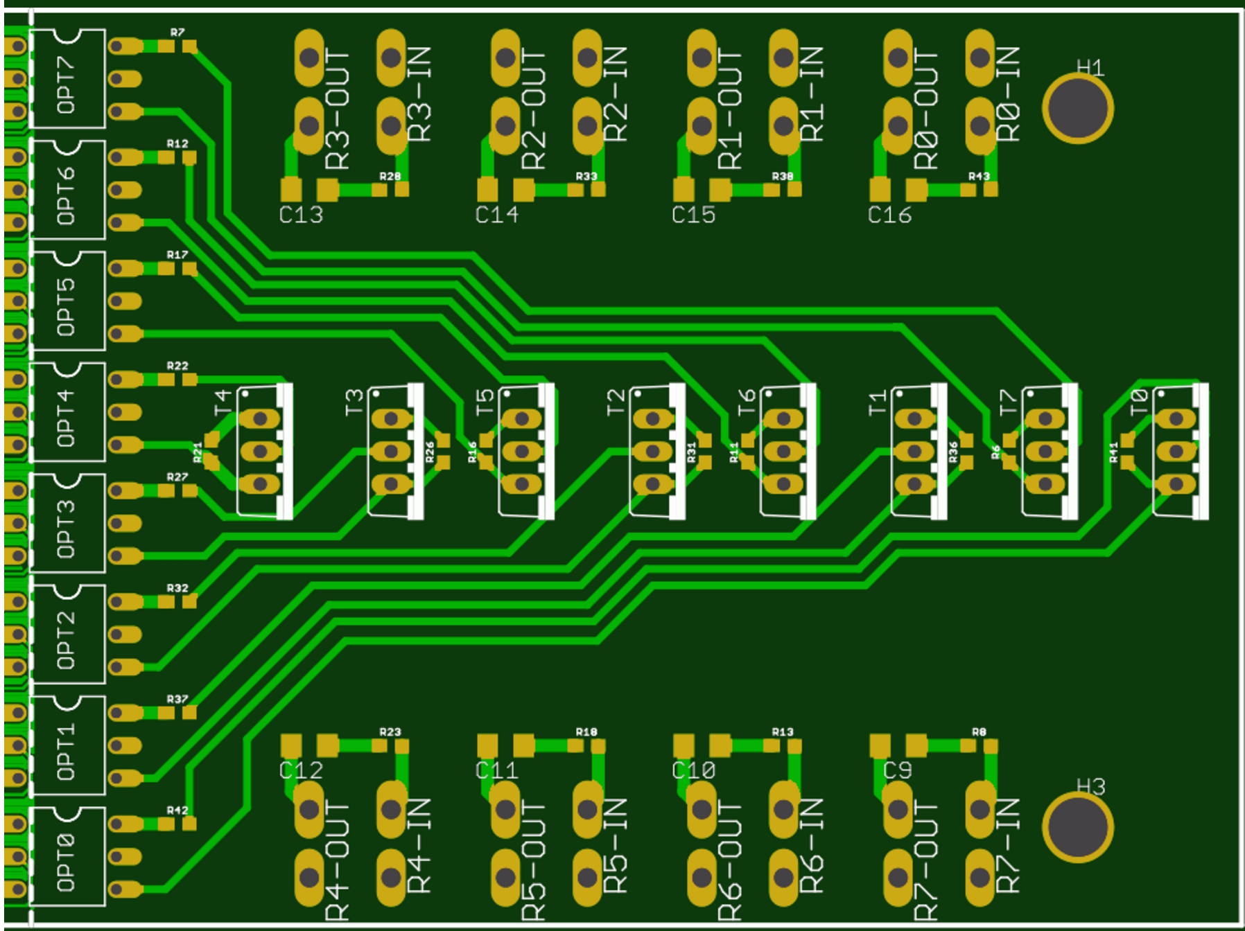
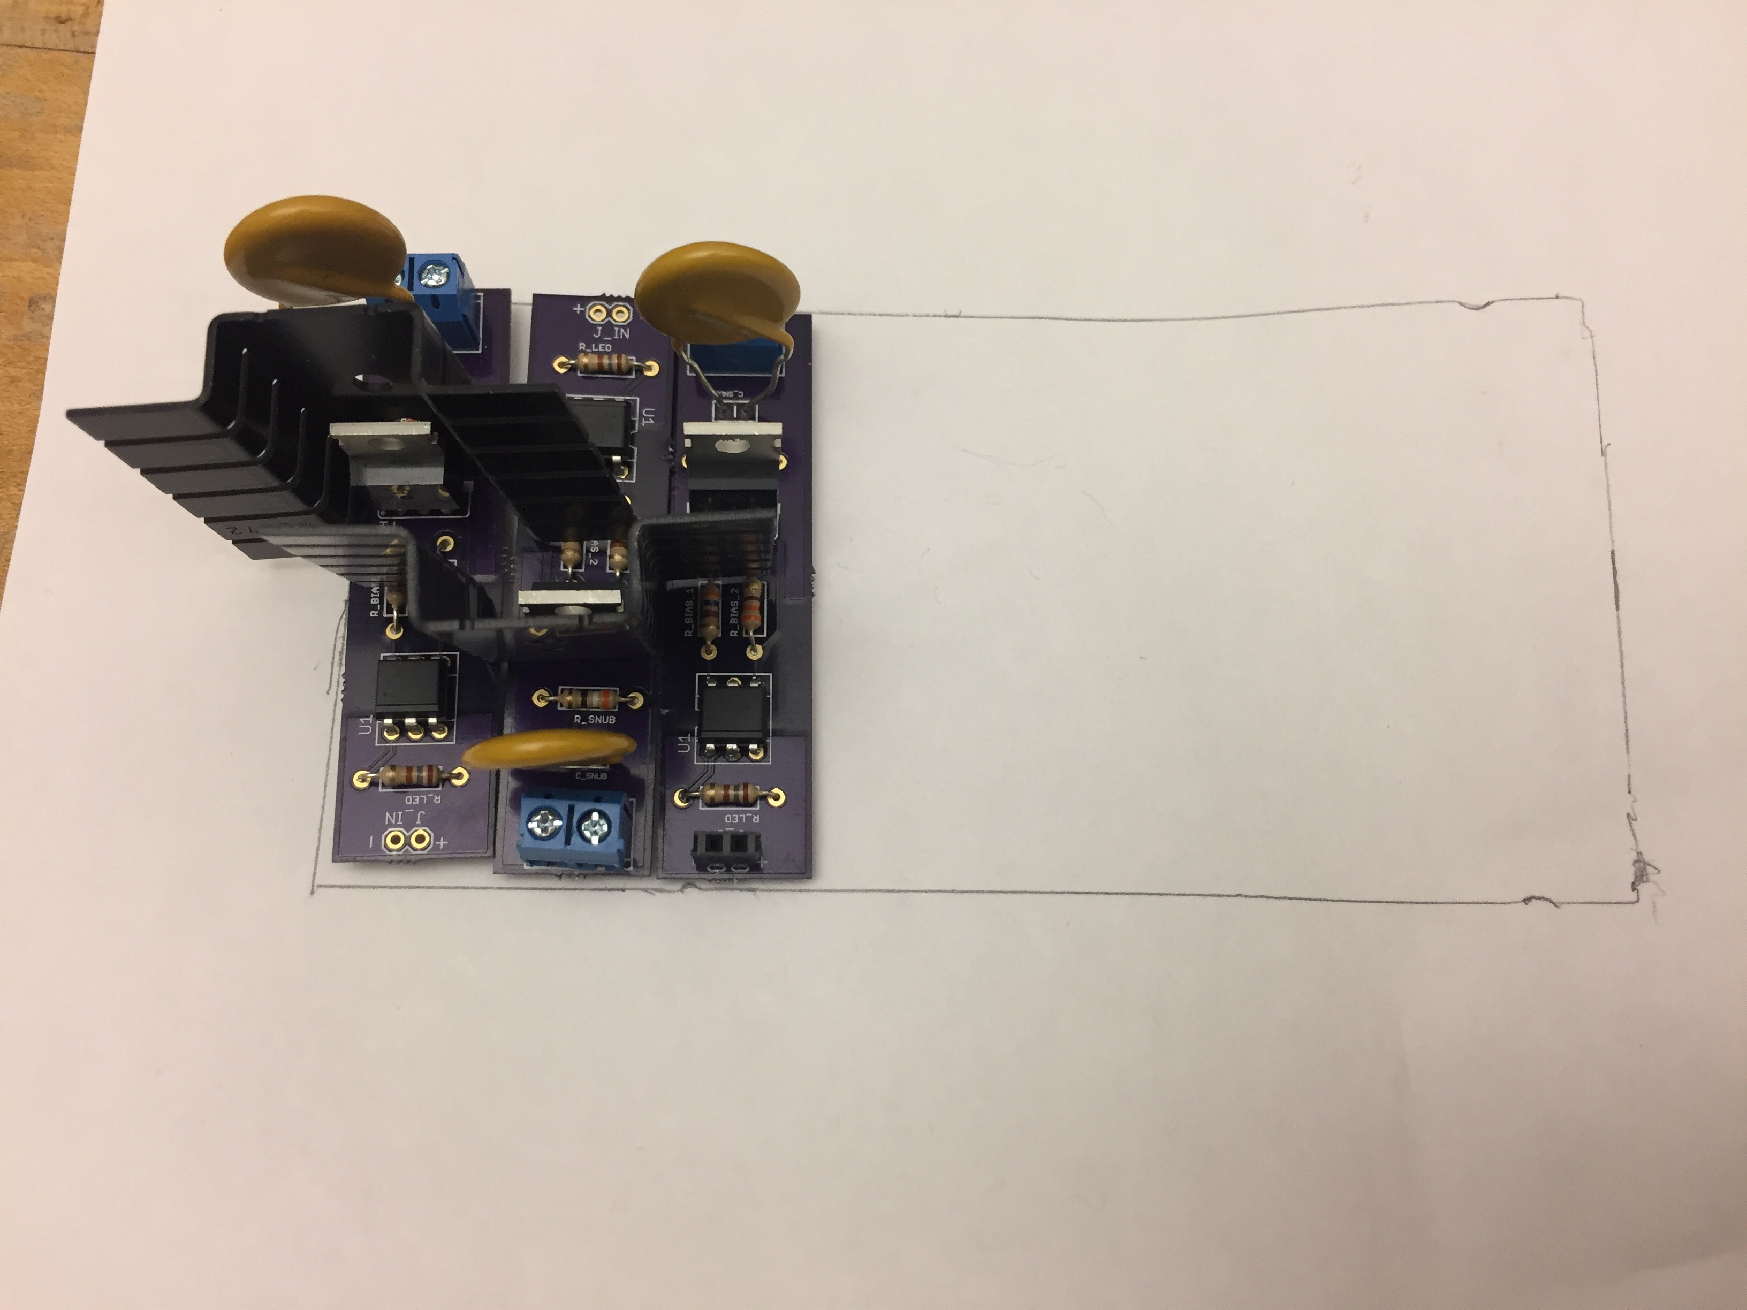
Results: Relays
Redesigned considerably smaller
TRIACs too close, heat sinks don’t fit
PCB Rev. 2 with proper positioning arrives next week
2.72”
Original Design
Relays not soldered in picture – too close for heatsinks
New design – no staggering required!
Notes:
Patrick

Slide 11
Results: Relays Heat Sink Tests
Temperature difference from ambient with each heat sink and at what load –
Trend is approximately linear
Notes:
Josh
Here’s simulation data collected on TRIAC power dissipation versus load current. The trend is roughly linear, and depends very little on power factor
This matches the datasheet!
(side note, the TRIACS are more than 99% efficient)

Slide 12
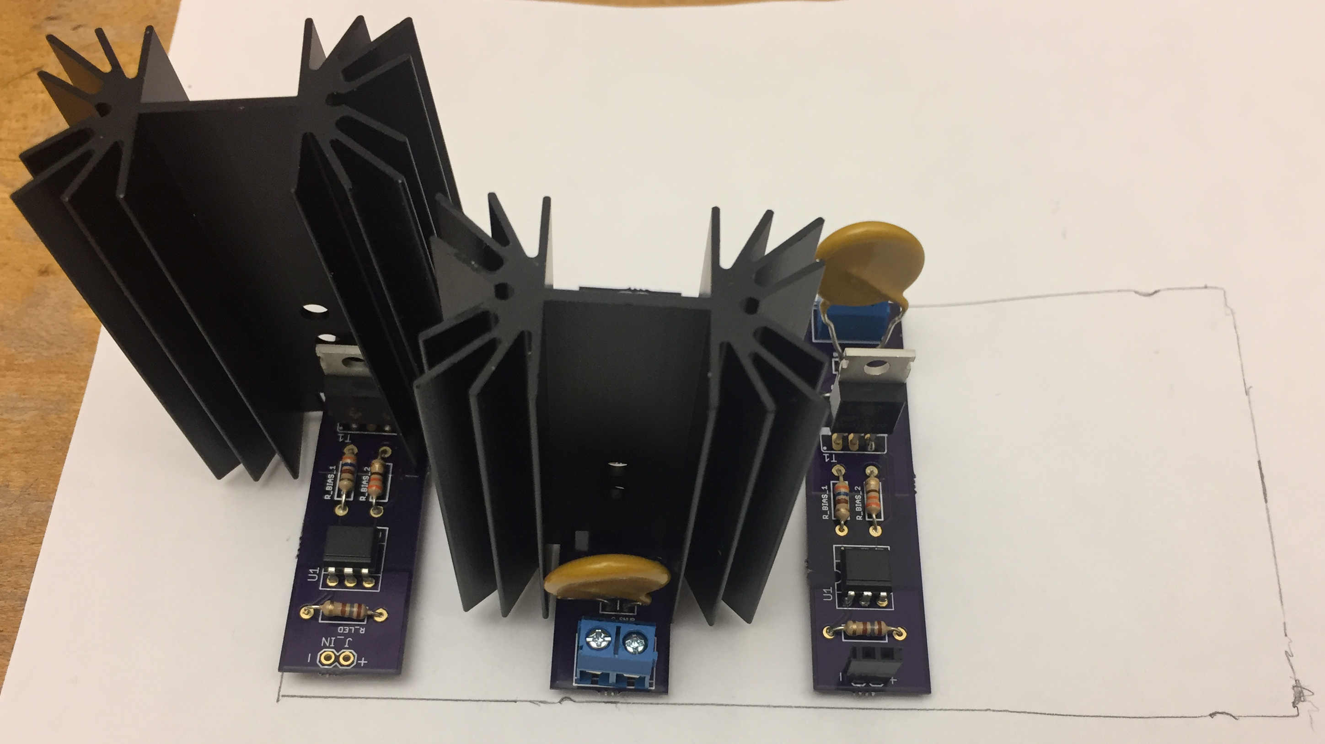
Results: Relays Heat Sink Tests
Current: 10 A
Ambient Temp: 24 C
TRIAC Temp (@ Ambient): 54 C
TRIAC Temp (@ 60 C): 90 C
Current: 10 A
Ambient Temp: 24 C
TRIAC Temp (@ Ambient): 82 C
TRIAC Temp (@ 60 C): 118 C
2.72”
5.6”
Bigger heat sink
Smaller heat sink
Target TRIAC Temp (@ 60 C / 10 A): 125 C
Both good for 10 A operation!
Notes:
Josh
Figure taken from BT139-800E data sheet

Slide 13
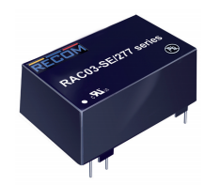
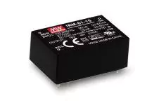
Results: Power Stage
PCB design doesn’t match footing
Rev. 1 with correct footing arriving next week
Cheaper custom solution simulations successful
-BUT-
Less expensive module discovered
0.8”
0.9”
1.5”
1.3”
Notes:
Patrick

Slide 14
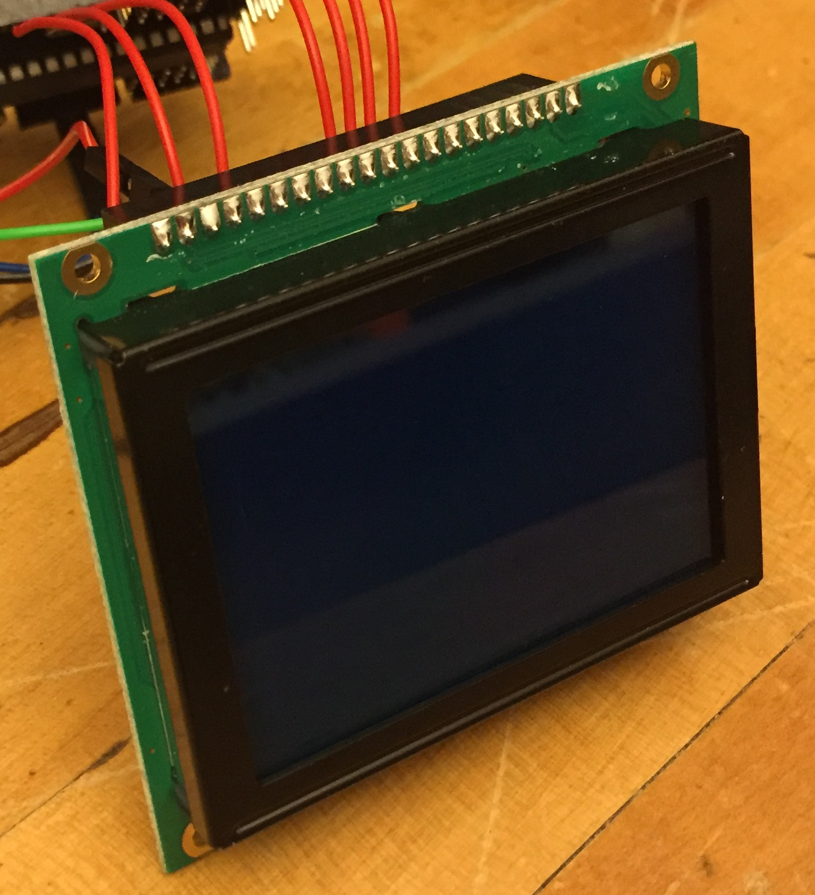
Results: User Interface (UI)
Current LCD malfunctioning, no longer working with graphics library
Will test with a new unit, same model
-OR-
Different LCD acquired - well known to work with desired graphics library
2.075”
2.953”
Graphic Display
Notes:
Patrick

Slide 15
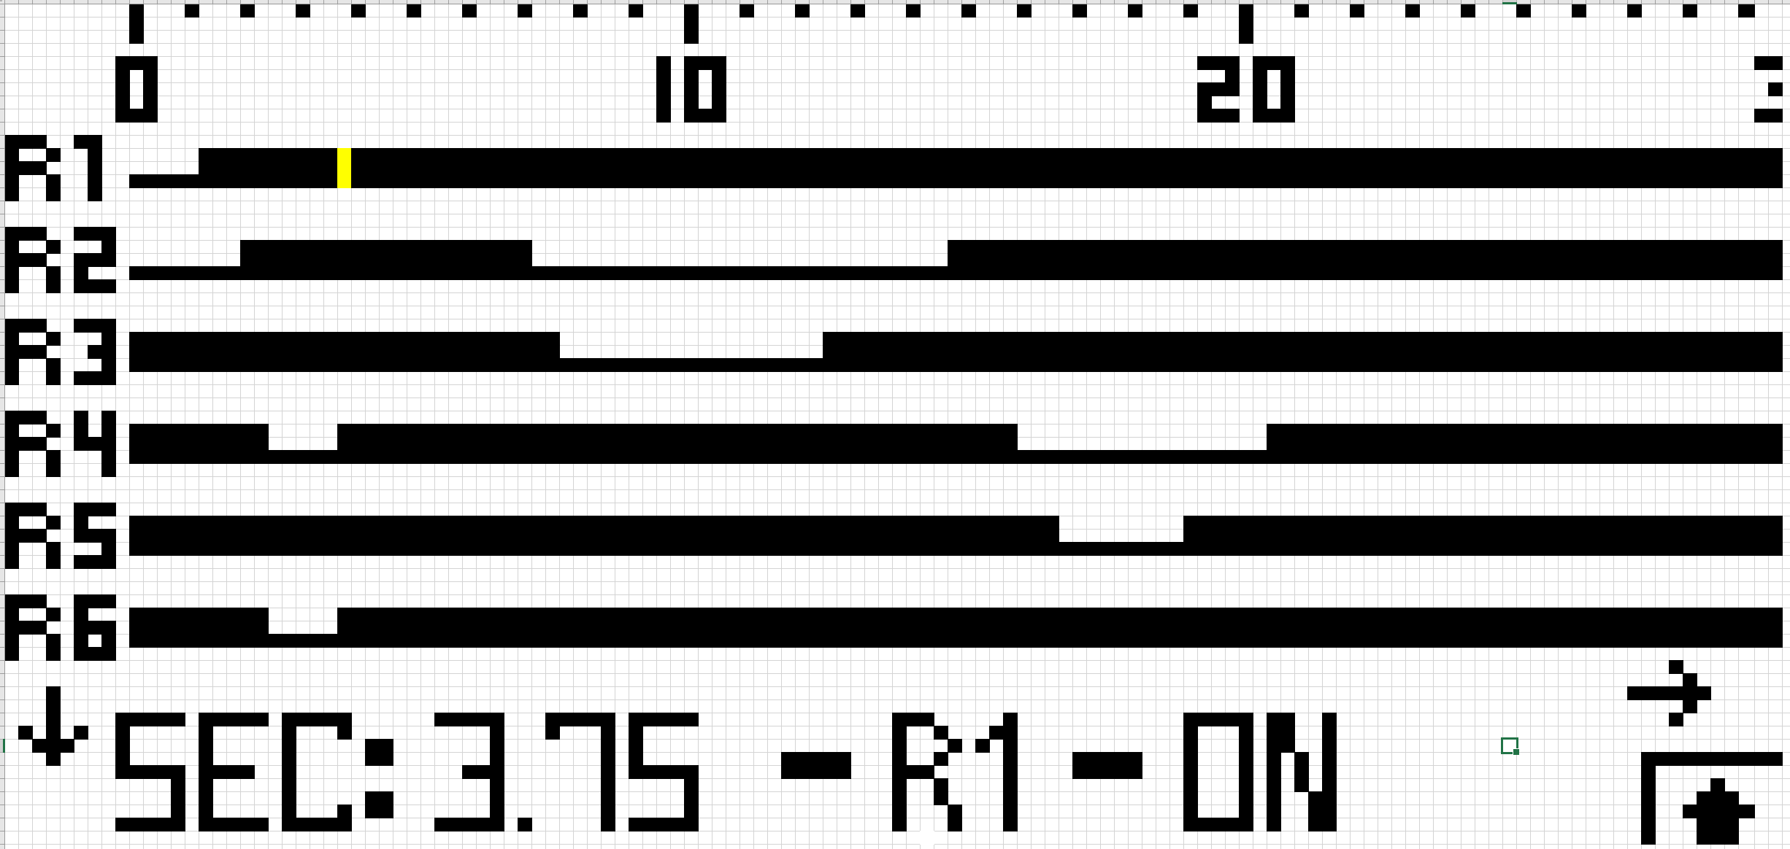
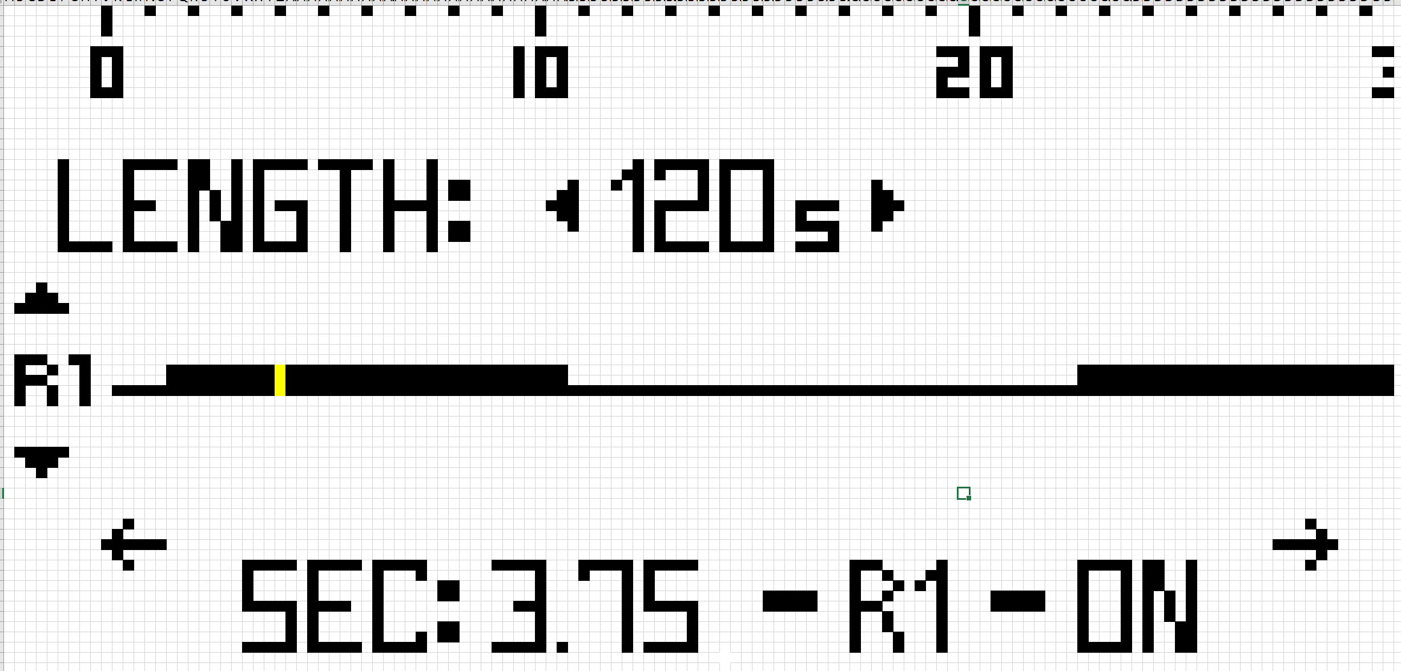
Conclusions: UI Design Unchanged
Display for LCD Screen
Capacitive button programming tested and successful
Each Pixel Represents .25 seconds
Notes:
Patrick

Slide 16
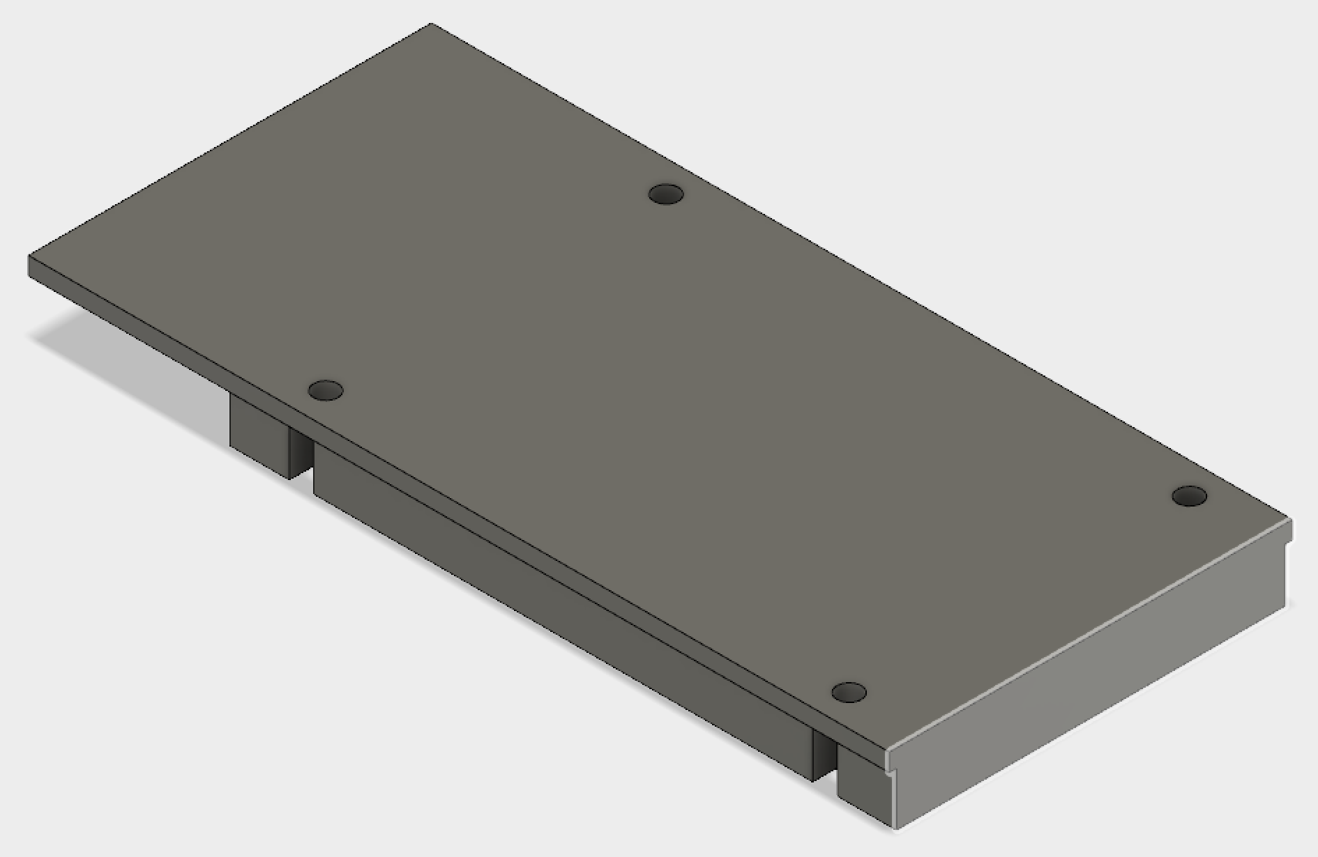
Results: Mounting Platform
PCB dimensions exceed electromechanical timer footprint
Raise PCB to overhang adjacent components in dishwasher control unit
Simple rectangular prism also drawn in CAD if no space conflict
Extruded aluminum
PCB is sturdy, mounting platform may not be necessary
Nylon spacers instead
2.82”
6.02”
4.66”
2.72”
Notes:
Josh

Slide 17
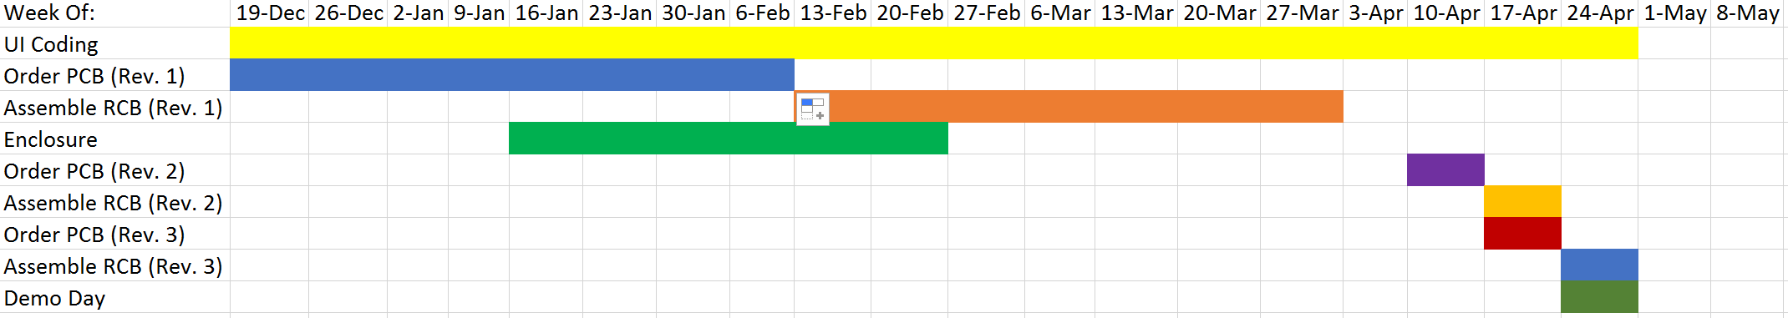
Schedule
Mar. 31 – Test Single PCB
Apr. 17 – Assemble & Test PCB Rev. 2
Apr. 18 – Make changes and order PCB Rev. 3
Apr. 28 – Present at design day with PCB Rev. 2, or 3 if ready
Notes:
Patrick

Slide 18
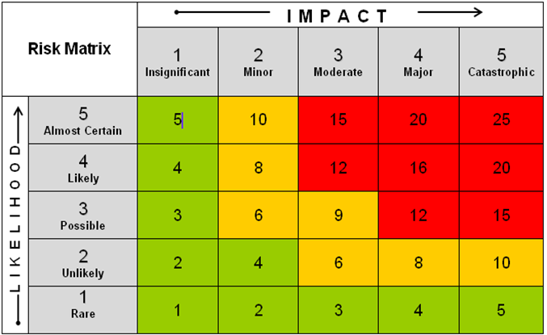
Risk Cube
UI Coding or LCDs Don’t Work
Smaller Heat Sinks Fail Original Requirements
Shipping Delays
PCB Mistakes
4
2
1
3
Notes:
Josh (Red – It happened, we need to deal with it; Yellow – it happened, already fixed; Green – Didn’t happen, no longer a risk)

Slide 19
Risk Assessment
UI Coding or LCDs Don’t Work
- Timer requires computer to program over USB connection
Smaller Heat Sinks Fail Original Requirements
- Confirmed 15 A cannot be dissipated in required temp. range given space limits, sponsor allows 10 A rating
Shipping Delays
- Rush items, spend more money
PCB Mistakes
- Already occurred in first prototype, Rev. 2 with fixes ordered
- No time for more than 3 revisions (Rev. 3 is final PCB)
Notes:
Josh

Slide 20
Estimated Unit Cost
Estimated cost does not include labor
Item | Cost
MCU | $3
8 Relays | $15
Power Converter | $6
LCD | $10
PCB + Mounting Platform | $5
Total (Target = $40) | $39
Notes:
Josh – Relay and MCU cost about 1.5x actual estimate – price could potentially be as low as $33

Slide 21
Team Assessment
Presentation Style
Readability of Slides
Clarity of Project Objectives and Deliverables
Clicker Scoring
A - “I get it” - Clear, Nice Job!
B - “I kind of get it” - Needs More Work
C - “I’m confused” - Needs Lots of Work

Slide 22
Who Is Capewell?
“Capewell Aerial Systems is a global leader in aerospace and life support. We are a respected provider of engineered products for aerial delivery, life support and tactical gear for military, law enforcement and humanitarian agencies worldwide. Founded in 1881, Capewell has thrived by helping customers conceive, engineer, prototype, manufacture and field test products that must perform flawlessly in critical situations.”
Back

